Slide 1
Team 302
Tyler Winder, Jose Nava, Sam Kohler, Tilak Raj Thanga Raj

Slide 2
Team Organization
Shared goals:
Be able to make a fully functioning product.
Meet the requirements set by the product description.
Learn valuable industry level skills that we can add to our current skill set.
Ensure that our design solves the problem given to us.
Make our product cost effective based on the budget.
Product Mission Statement:
To design a product that is able to provide measurements related to its environment defined by the user.

Slide 3
Project Requirements
Create a mobile weather monitoring station
Must measure at least two environmental conditions, (wind speed, humidity, temperature, etc.)
Broadcast data to the internet via WiFi
Produce a controlled response with an actuator

Slide 4
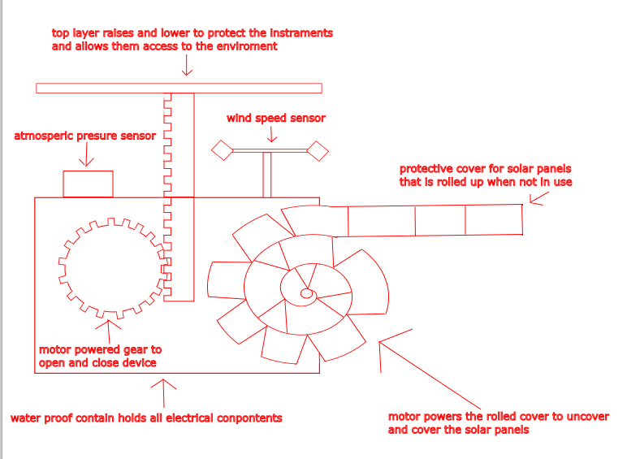
Solar Panel Protection
Installed next to the solar panel that when it detects conditions that cause storms that would produce strong winds or hail.
This device will activate a motor that will unroll a stored protective covering over the solar panel in order to protect it from hail and other storm debris.
Retractable top that will cover the sensors and protect them from hail, debris, and strong winds.
The lid will raise up and allow the sensors to detect the weather conditions every hour before the lid will lower again.

Slide 5
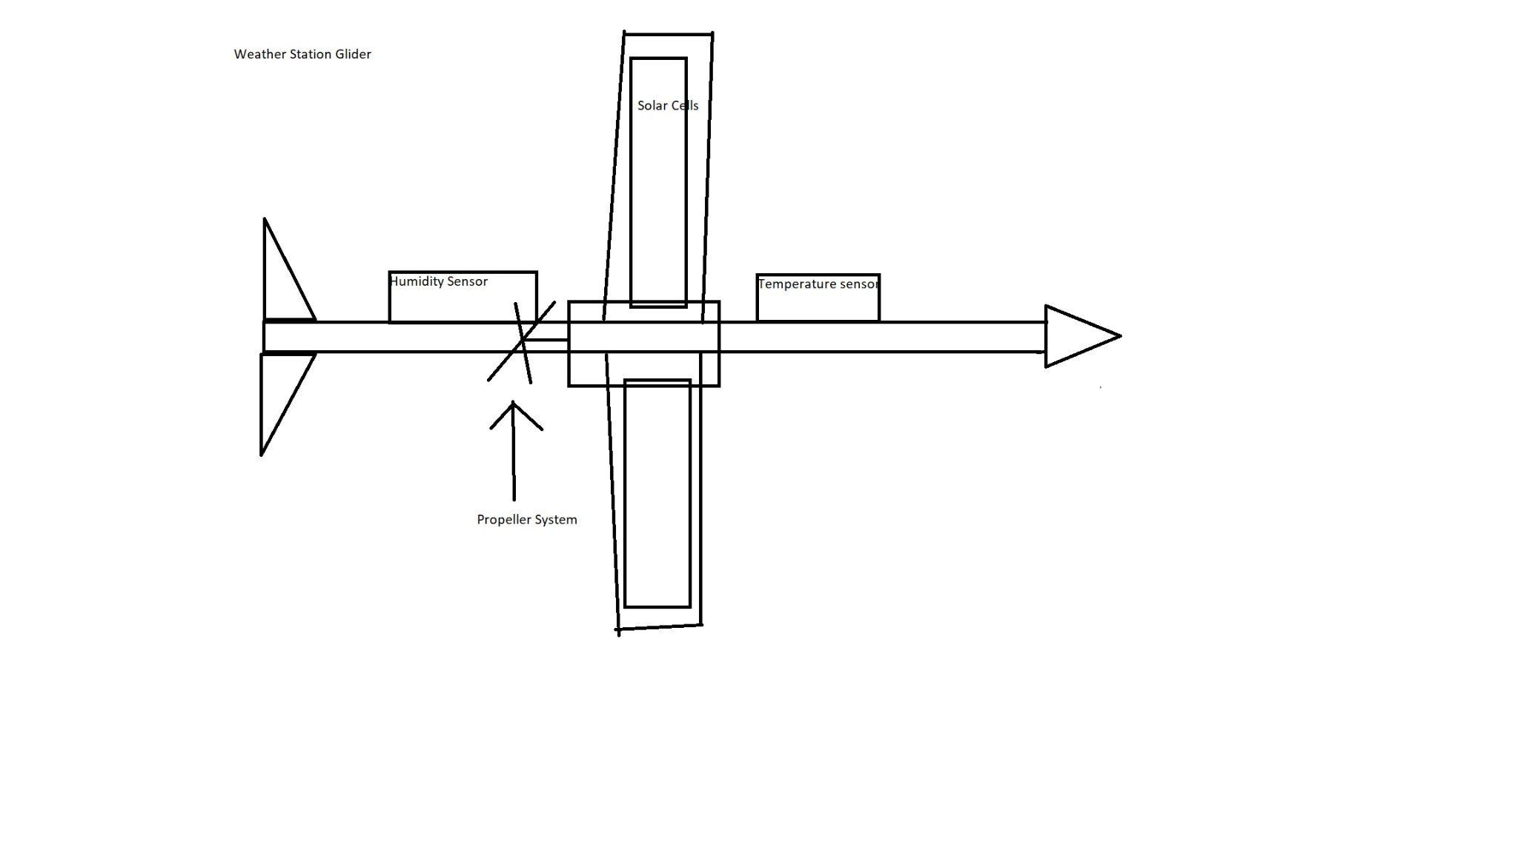
Weather Station Glider
Weather station glider is a type of unmanned aerial vehicle (UAV) that is specifically designed for collecting weather data.
Fly at high altitudes and over long distances, allowing them to gather information on temperature, humidity.
Used in remote or hard-to-reach areas.
Provide valuable data for weather forecasting, climate research, and other applications.

Slide 6
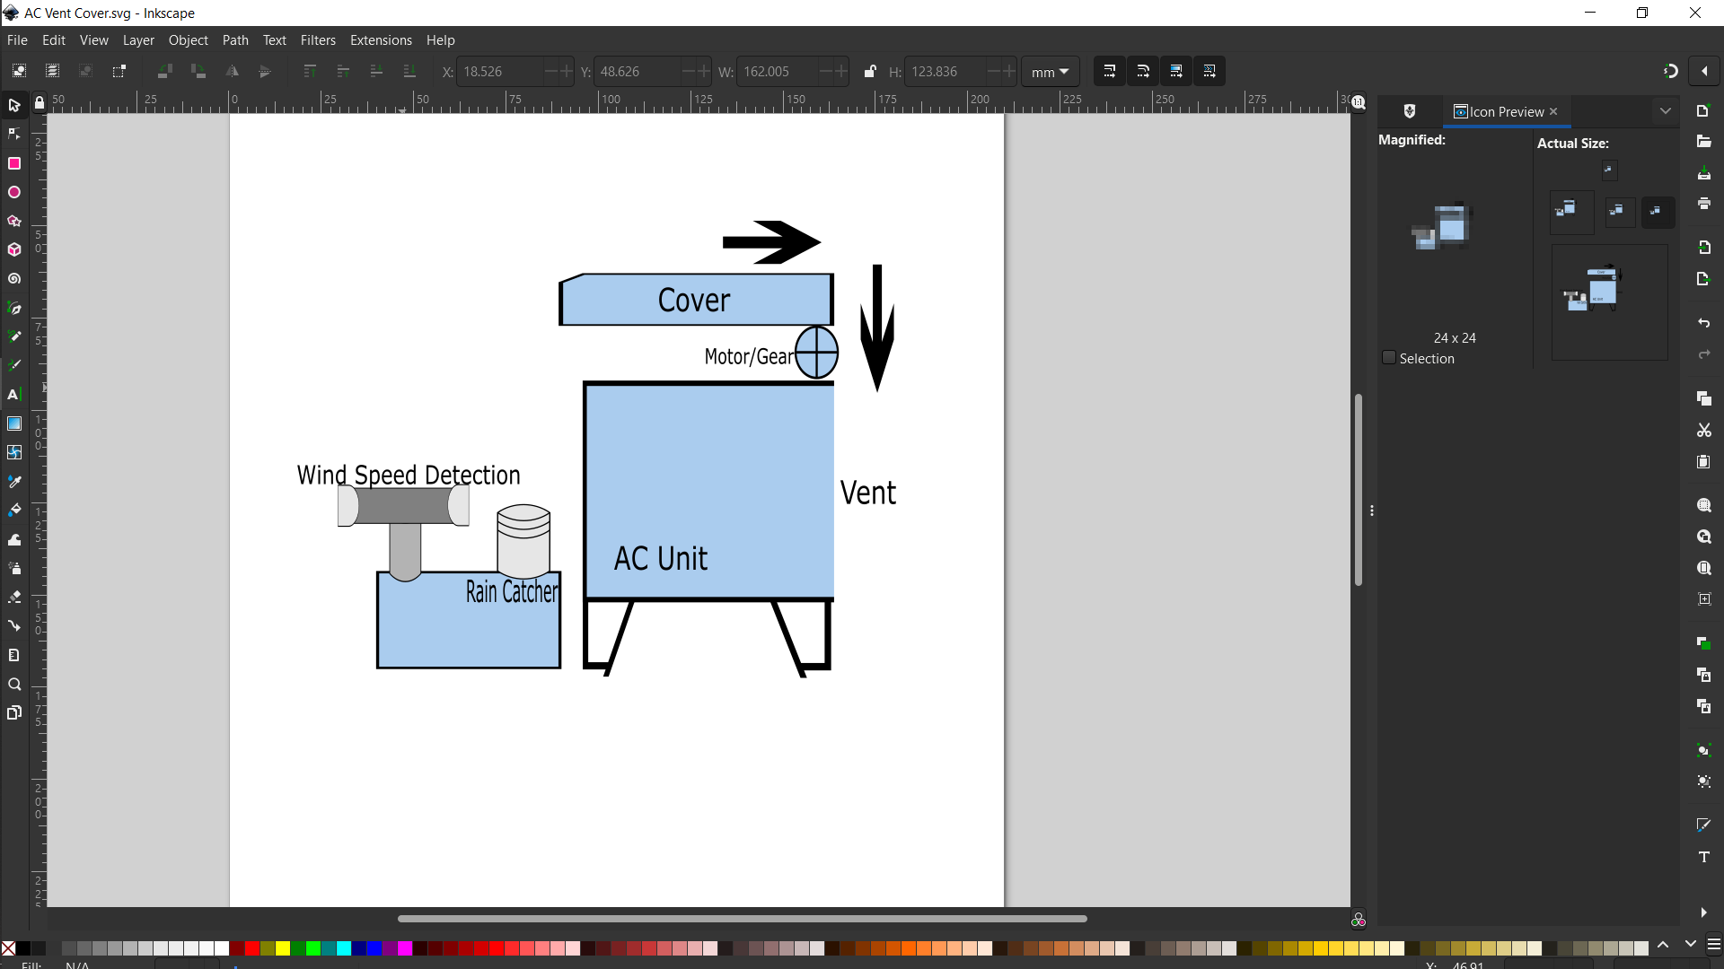
Automated AC Unit Cover
Protective cover deployed to cover openings of a typical ac unit during a monsoon or storm.
Deploy during a storm to avoid anything else from entering/damaging the AC system.
Reservoir fills with X amount of liquid or fills too quickly the cover will deploy in order to cover the vent opening.
Device senses wind speed that exceeds X amount will deploy the cover until it reaches acceptable levels

Slide 7
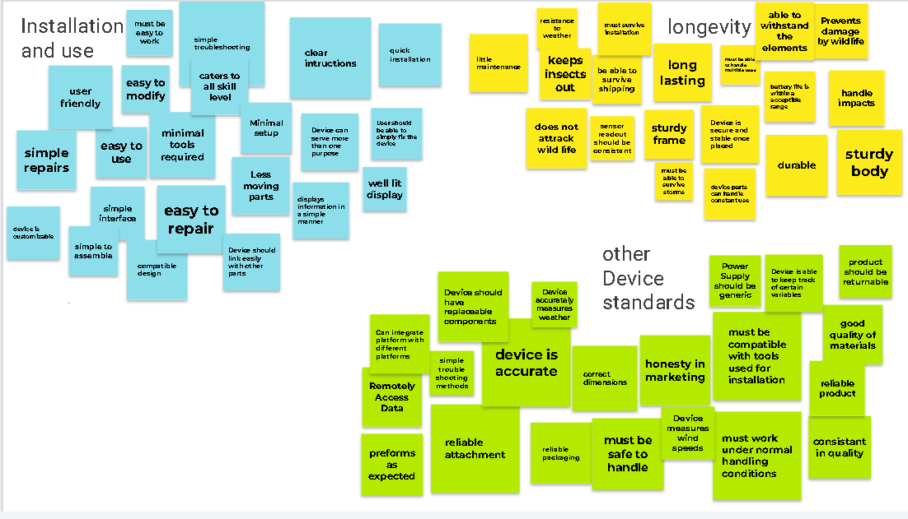
User needs
Most unexpected user needs
Need to be insect and animal proof

Slide 8
Design Ideation
Organization of your brainstorm session
Set a clear agenda and goals for the session. This will help participants understand the purpose of the meeting and what is expected of them.
Brainstorming: Allow team members to share their ideas freely, without interruption or judgement. Encourage creative thinking and out-of-the-box solutions. Use sticky notes or a whiteboard to capture the ideas.
Developed an Voting strategy as an action plan to pick our top Ideas

Slide 9
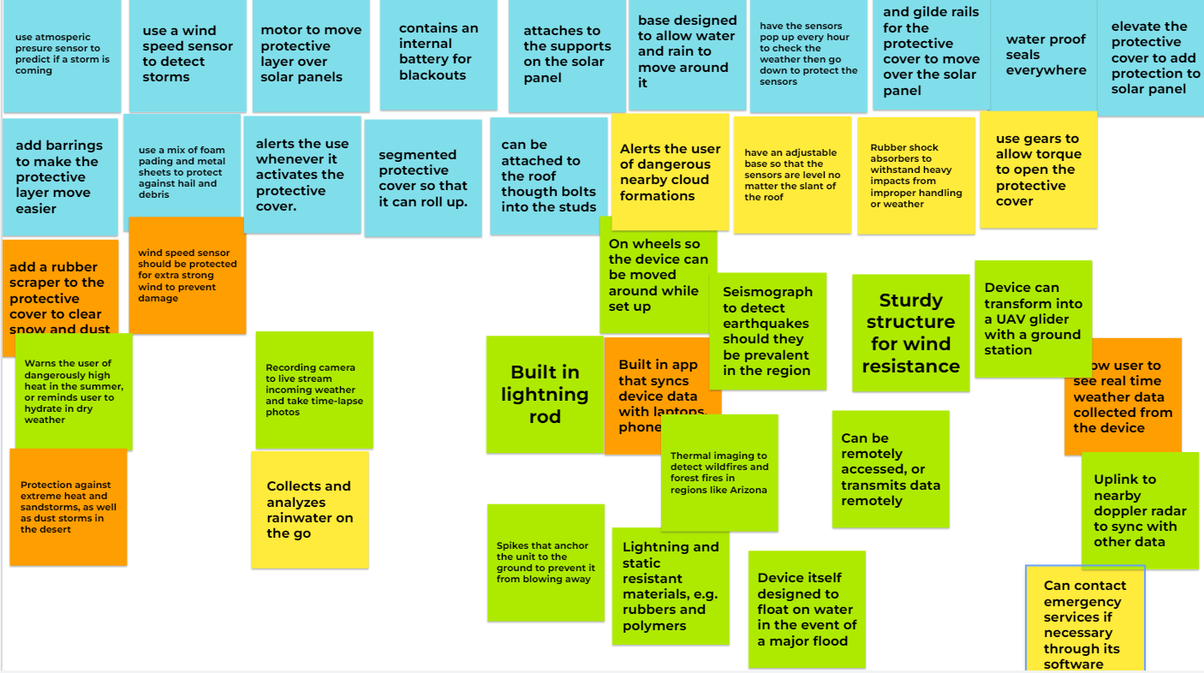
Design Ideation
Mid Process

Slide 10
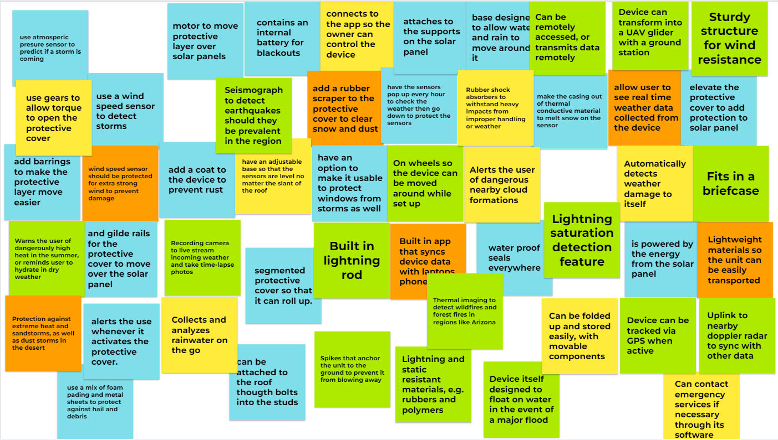
Design Ideation

Slide 11
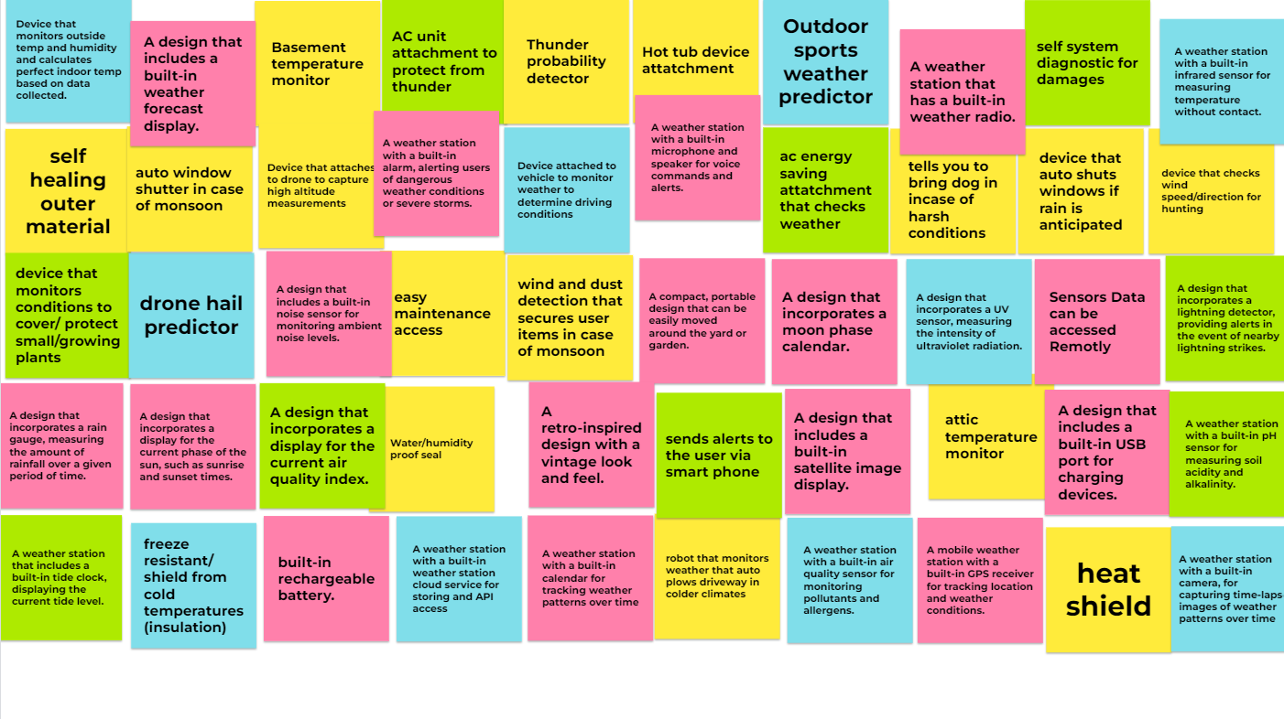
Design Ideation

